Slide 1
E-Commerce Case Study
Created and Presented by
Name: Rishi Pratap Yadav
Emp Id: 3145887

Slide 2
Summary
We have designed a scalable and reliable e-commerce system that ensures smooth customer journeys from browsing to checkout. The platform is built in a modular way, where key business functions such as products, orders, payments, inventory, and customer communication work independently while remaining fully integrated.
Overall, the architecture provides a secure, high-performance foundation that supports business expansion, operational efficiency, and a consistent customer experience.

Slide 3
Functional Requirement
User can sign up, login and logout.
Products list should be visible on the page.
User can search product by name and category.
User can filter products.
User can add, update, remove products from the cart.
User can place order
Notify user about order placed
User should be able to make payment for the product
Inventory must be updated after purchase.

Slide 4
Non Functional Requirement
System should be auto scalable for peak events.
Availability up to 99.99%
Fault Tolerance
Strong consistency for Inventory
Graceful Degradation
Low Latency(Page load p95: <2.5sec, API Response : 200ms-300ms, Search -300ms – 500ms)
Ability to handle thousands of concurrent requests

Slide 5
Assumptions
Mostly browsing/search traffic(80%), checkout traffic(20%).
We will have responsive website shown on desktop and mobile.
Mobile application is not asked by client.
The system meets regulatory, privacy, and audit requirements.
Third party integration with Payment gateway and Logistics.

Slide 6
Feedback from Interim Demo
Show each DB per service
Show cross cutting concerns in HLD
Improve icons or colour coding for different components
Show where product images and invoices would be stored.

Slide 7
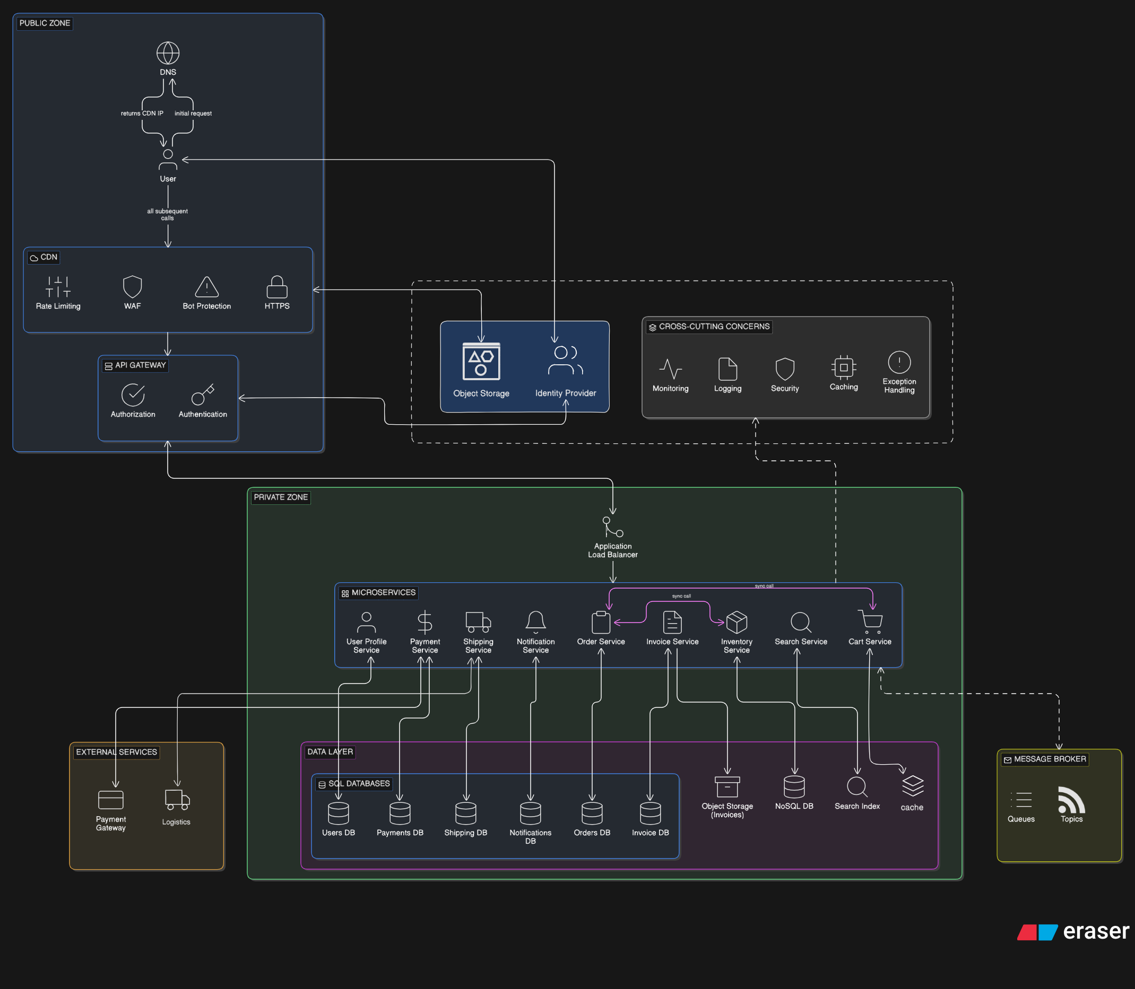
HLD

Slide 8
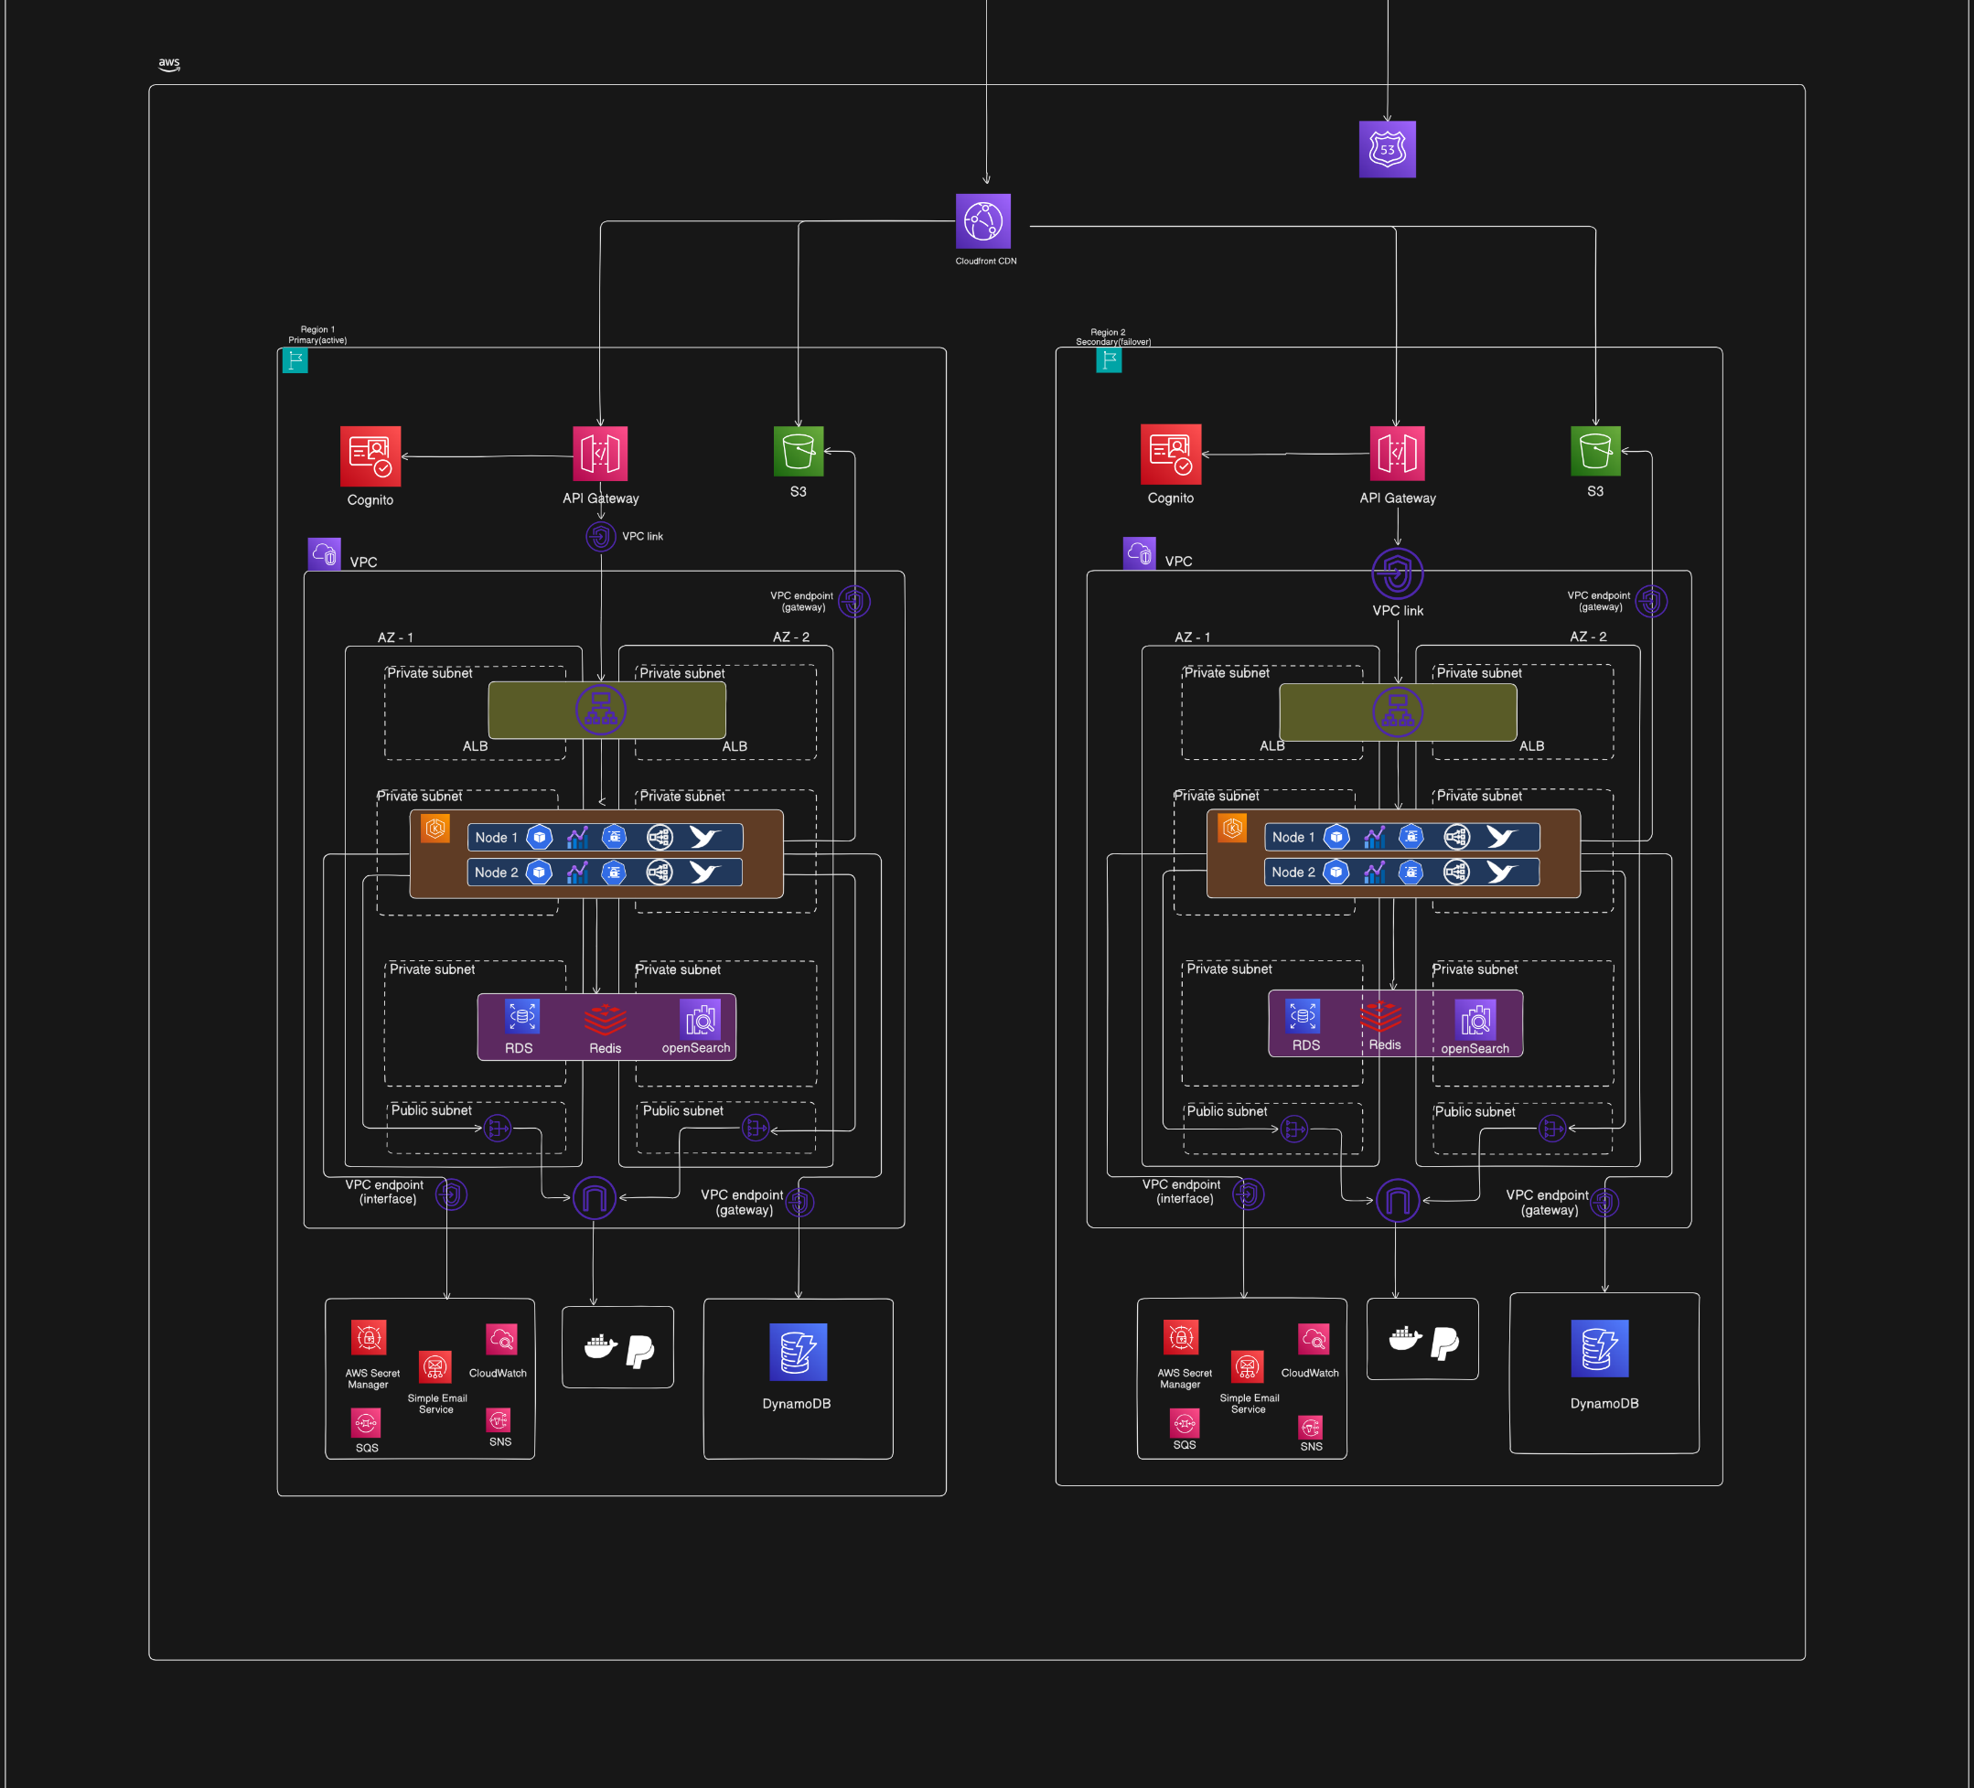
Deployment Diagram

Slide 9
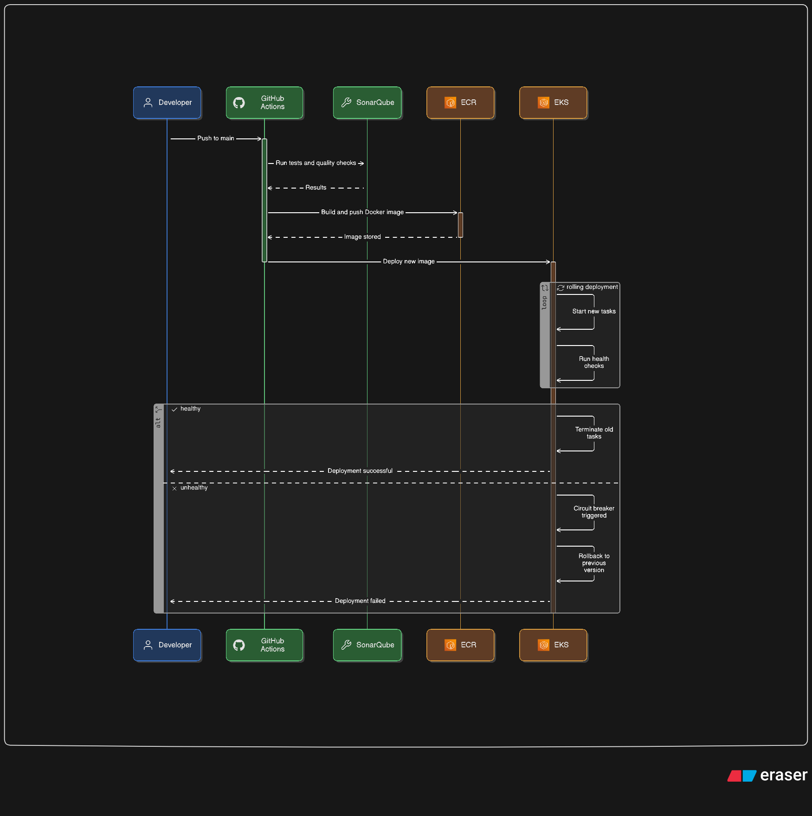
Frontend CI/CD

Slide 10
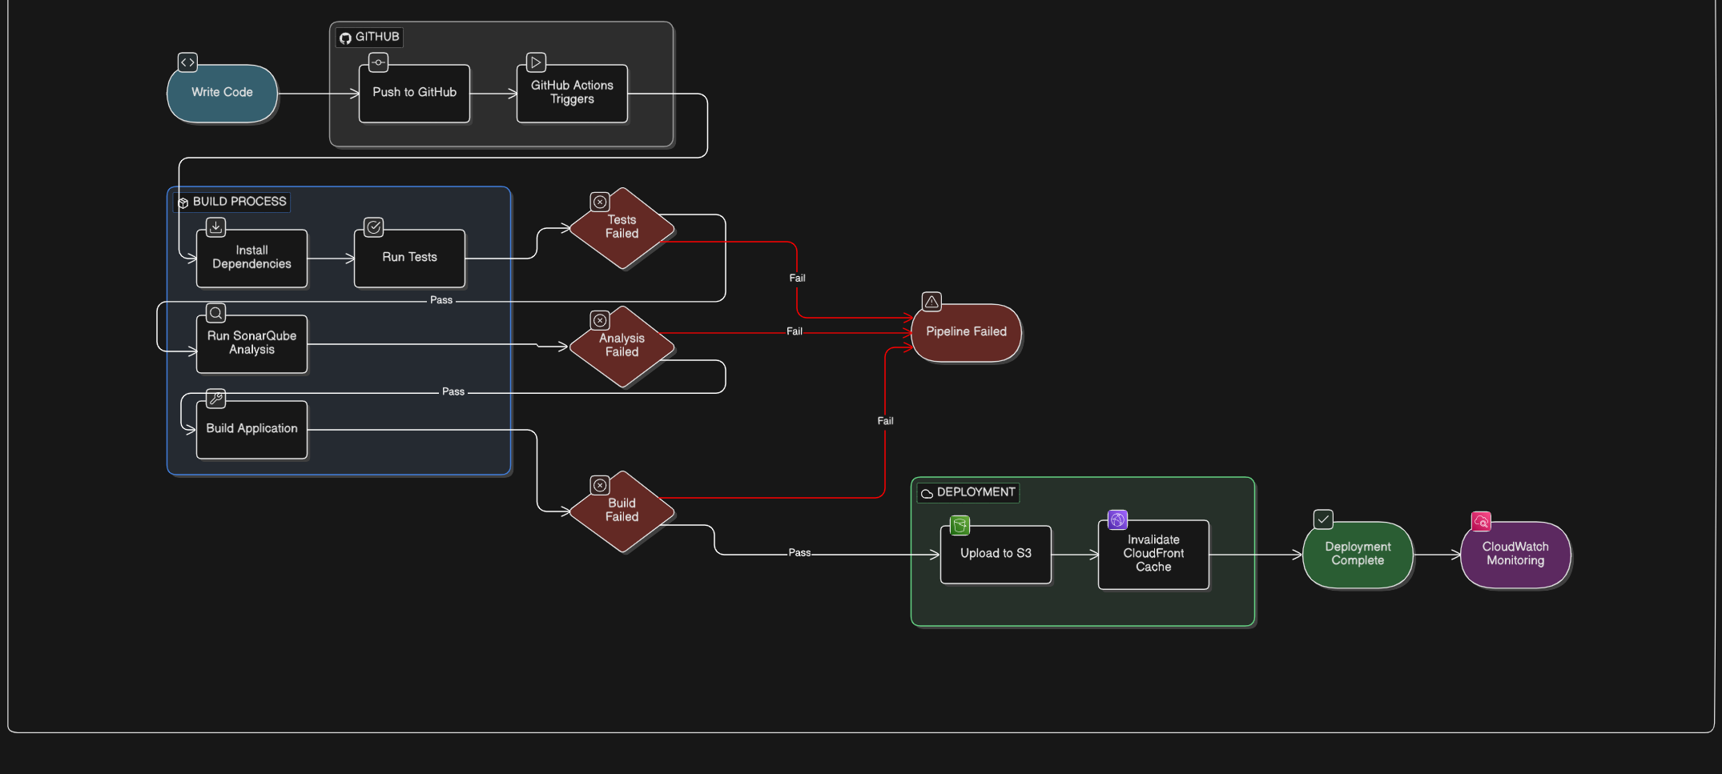
Backend CI/CD

Slide 11
DAR
Failover Strategy – DAR
DR strategy – DAR

Slide 12
Demo

